Slide 1
Welcome to “Success in Doctoral Research”
12:30pm – 1:00pm

Slide 2
Student Panelists
Maryanne Long
maryannelong@ufl.edu
Charlotte Bolch
cbolch@ufl.edu
Nidish Vashistha
nidish@ufl.edu
Ranjeet Randhawa
r.randhawa@ufl.edu

Slide 3
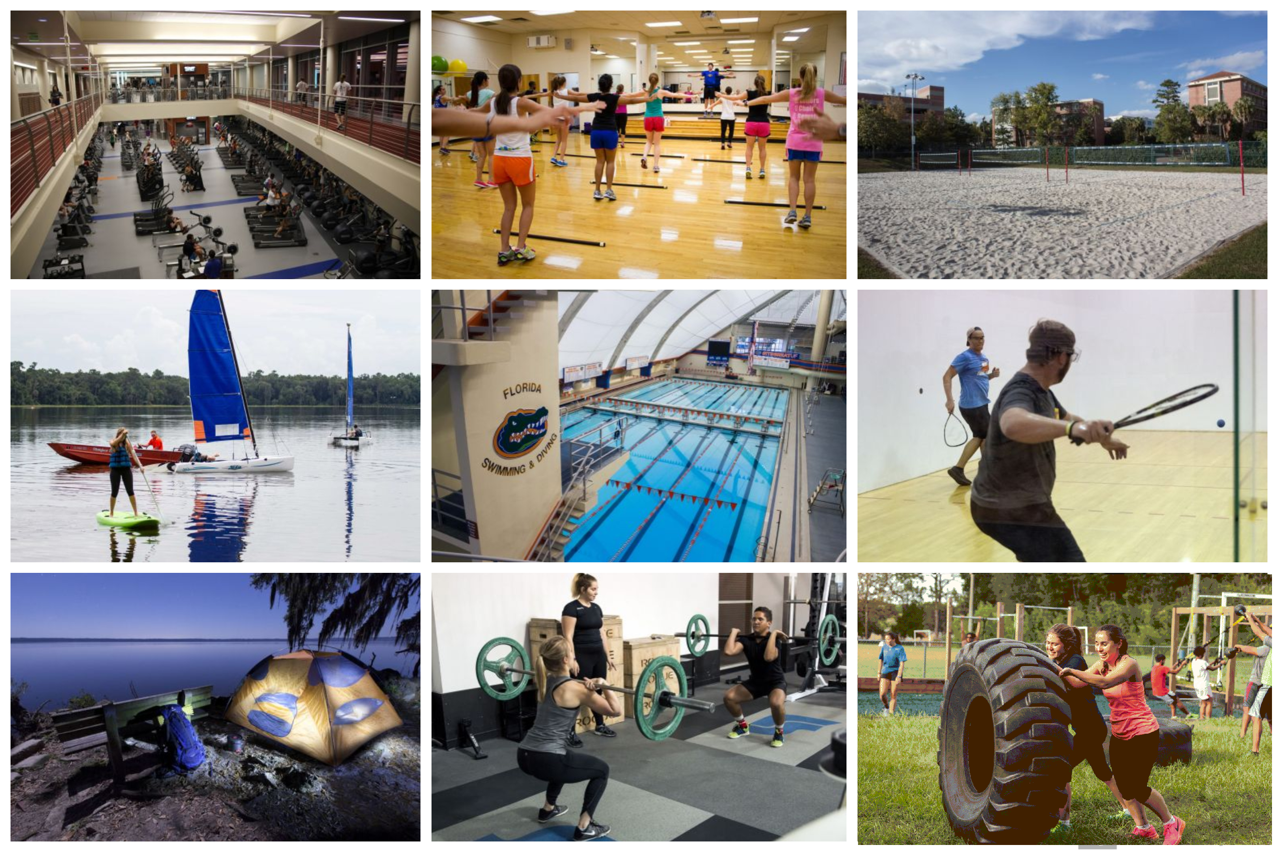
Fitness, Sports & Outdoors
Two Fitness Centers
Group Fitness Classes
Courts to play with friends
Sports Student Organizations
Equipment Checkout
Outdoor Trips & Gear Rental
Boot camp – Outdoors
Lake Wauberg (Water Sports)
UF Recsports

Slide 4
Wellness Coaching
Stress management
Time management
Sleep habits
Eating habits
Study skills
Alcohol and other Drugs
Body Image & Eating concerns
Interpersonal violence prevention
Sexual Health
Quitting Tobacco
Gatorwell

Slide 5
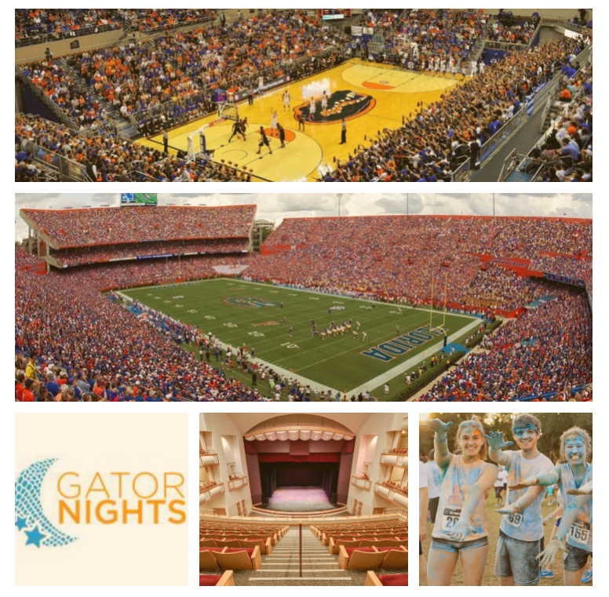
Watching Movies, Sports & Arts
Spring Basketball
Fall Football
Gator Nights – Movies, Karaoke, Drawing, Games
Arts – Concerts, Dance, Band Performance
FloridaGators |GatorNights | UF Performance

Slide 6
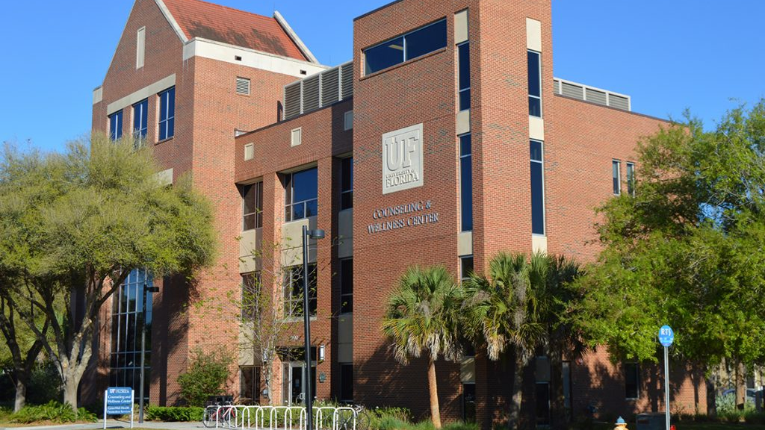
Counselling and Wellness center Resources

Slide 7
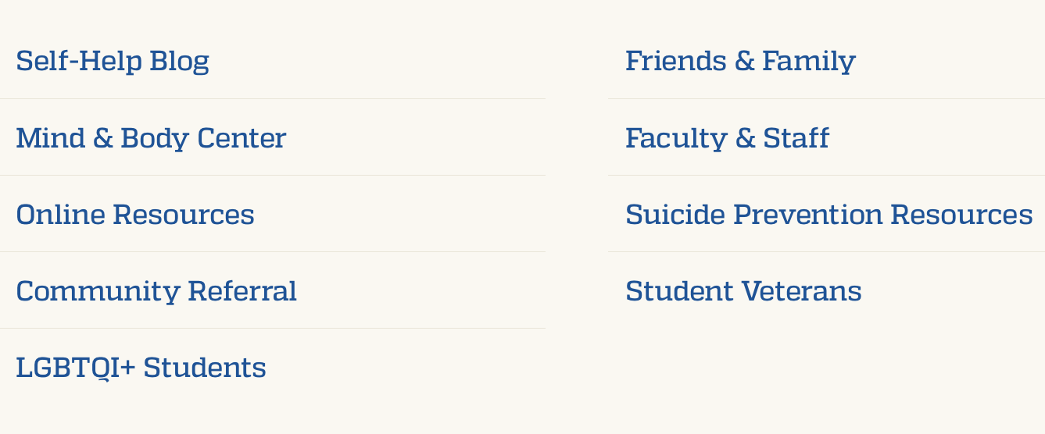
Services and Resources

Slide 8
ELIGIBILITY & FEES
ELIGIBILITY
All currently enrolled UF students are eligible for services at CWC.
FEES
Services fees are already included in student tuition fees.

Slide 9
Location and Hours
Counseling and Wellness Center Address:
3190 Radio Road Gainesville, FL 32611-2662 P: (352) 392-1575 F: (352) 273-4738
Office Hours:
Monday–Friday, 8am–5pm
Crisis/Emergency Walk-in Hours:
Monday–Friday, 9am–4pm

Slide 10
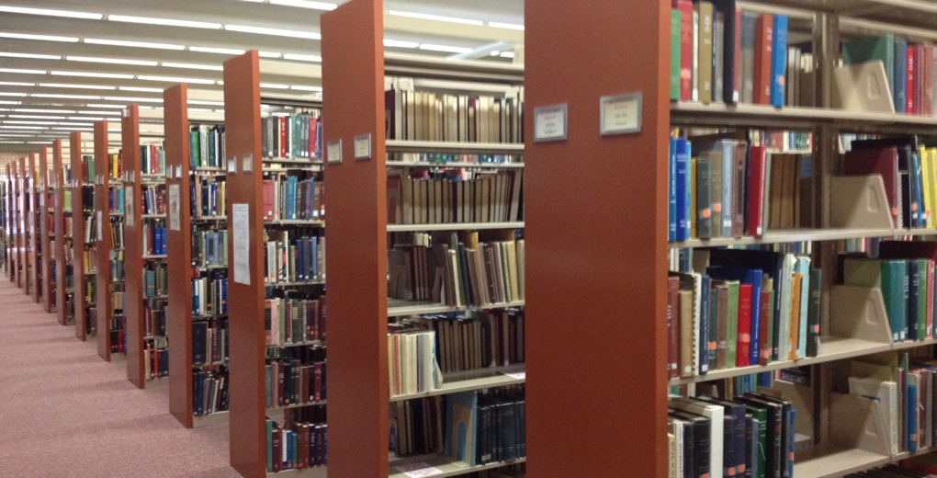
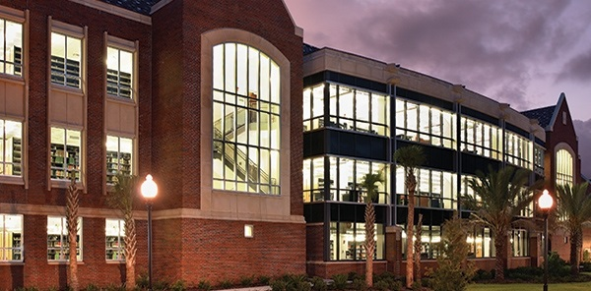
Study Resources
Marston Science Library
Science and Engineering Library
Library West
Humanities and Social Sciences Library
Graduate Study Floor- need to activate UFID card
Newell Hall
24 Hours study space for both Undergraduate and Graduate students

Slide 11
International Center Workshops
CPT, OPT, and STEM OPT!
Please attend to learn about your ability to legally do an internship during your program of study and to work after graduation.

